Slide 1
Designing Custom Circuit Boards (Abridged)
Michael Johnson-Moore
Presented Apr. 12, 2025 at URS
Elliot T. Bowers Honors College
Sam Houston State University
Notes:
Everything in this presentation is simplified for laypeople.

Slide 2
Thanks And Acknowledgements
Elliot T. Bowers Honors College
Funding
Hosting this presentation
Dr. Iftekhar Basith
Faculty Advisor
Dean Bell
Allowing me to do a thesis on this project.

Slide 3
Thanks And Acknowledgements
American Society for Engineering Education
Peer Review and Future Presentation (hopefully)
Montreal, Canada, June 22-25, 2025
Paper already accepted
Pabasar S.
Artist of Title Font “Cirquee”

Slide 4
Disclaimer of Abridgement
StudentSPEAK: 40 min
Removed project info
Poster session
Process & Issues
Notes:
This presentation was originally presented at an Honors StudentSPEAK event as a 40-minute presentation. To compress it to 12 minutes for this presentation, the information specific to my project was removed. This presentation only covers the process and issues I encountered.

Slide 5
Overview of PCB Design

Slide 6
Overview of PCB Design
PCB – Printed Circuit Board
Electronic circuit acid-etched onto copper
Multiple layers
Components – resistors, integrated circuits, etc.

Slide 7
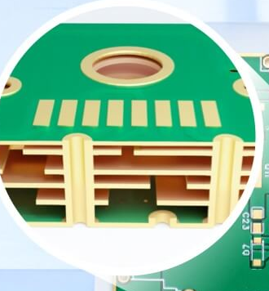
Multiple Layers
Components on outer layers
Signals/Power on inner layers
Solder Spots called “pads”
Wires called “traces”
“Vias” connect layers
Image Source: JLCPCB (https://jlcpcb.com/) Feb. 16, 2025

Slide 8
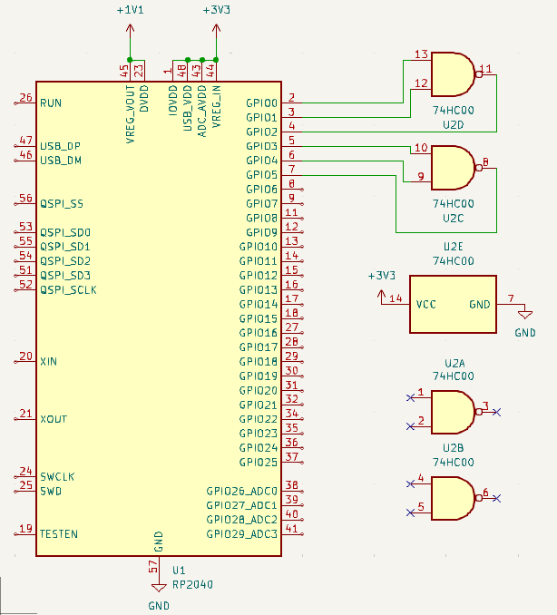
Design Process
Select Major Components – CPUs, connectors, etc.
Place components on schematic, select “footprint”
Connect Pins
Send to PCB Design
This design is simplified and would not actually work.

Slide 9
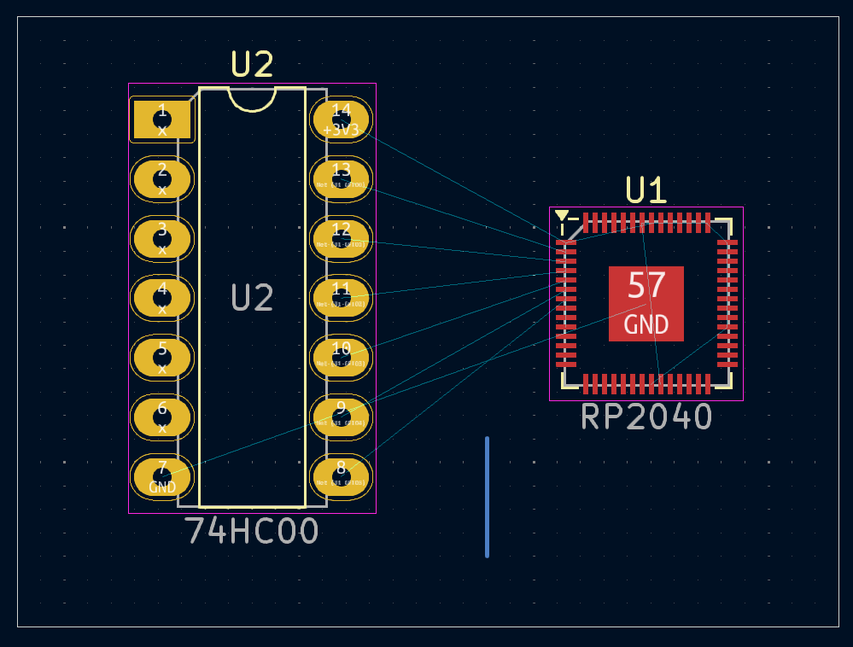
Design Process
Setup CAD Software
Define Board Edge
Place “footprints” where desired.

Slide 10
Color meaning
Yellow – Printed on Board
Gold – Copper on all layers
Blue lines – pads should connect
Red – Copper on top layer
Pink and thick gray – component area
Thin gray – board outline (cuts)
Blue – Copper on bottom layer

Slide 11
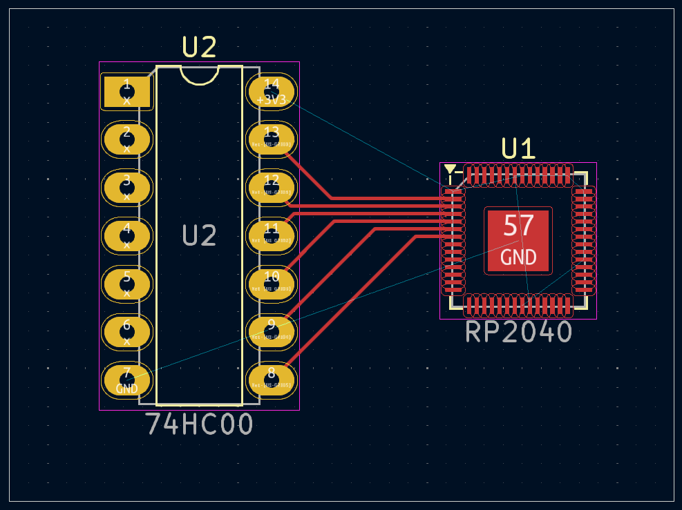
Design Process
Run traces between pads which need to connect.

Slide 12
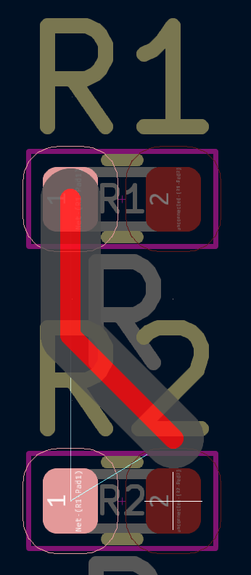
Modern CAD Software will not allow connecting the wrong pads

Slide 13
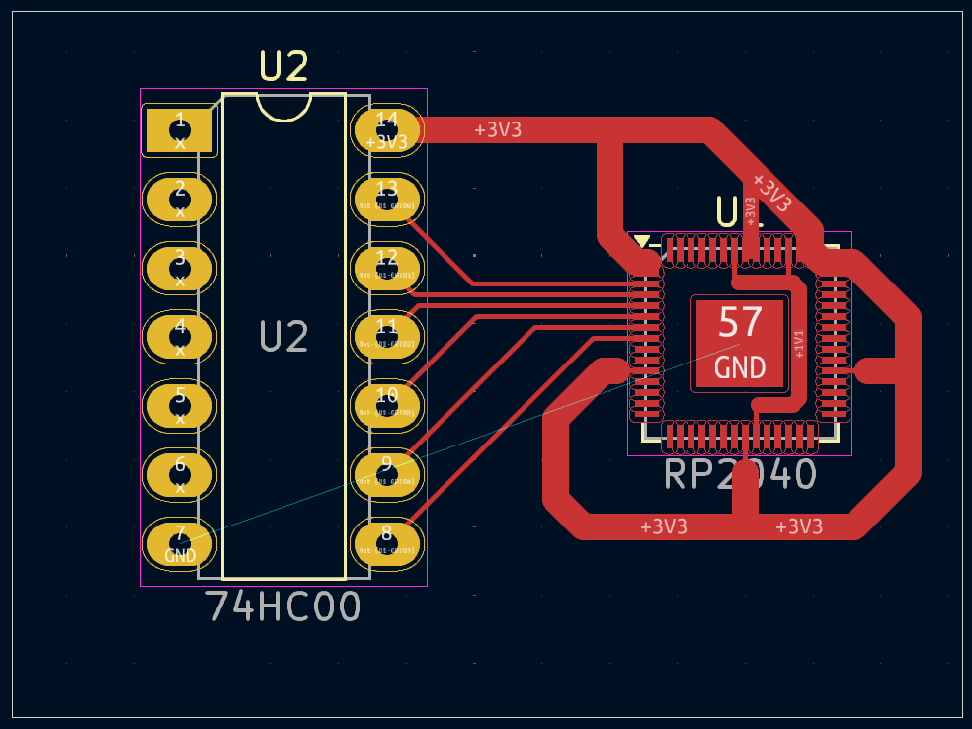
Design Process
Power pins need thicker traces, however…

Slide 14
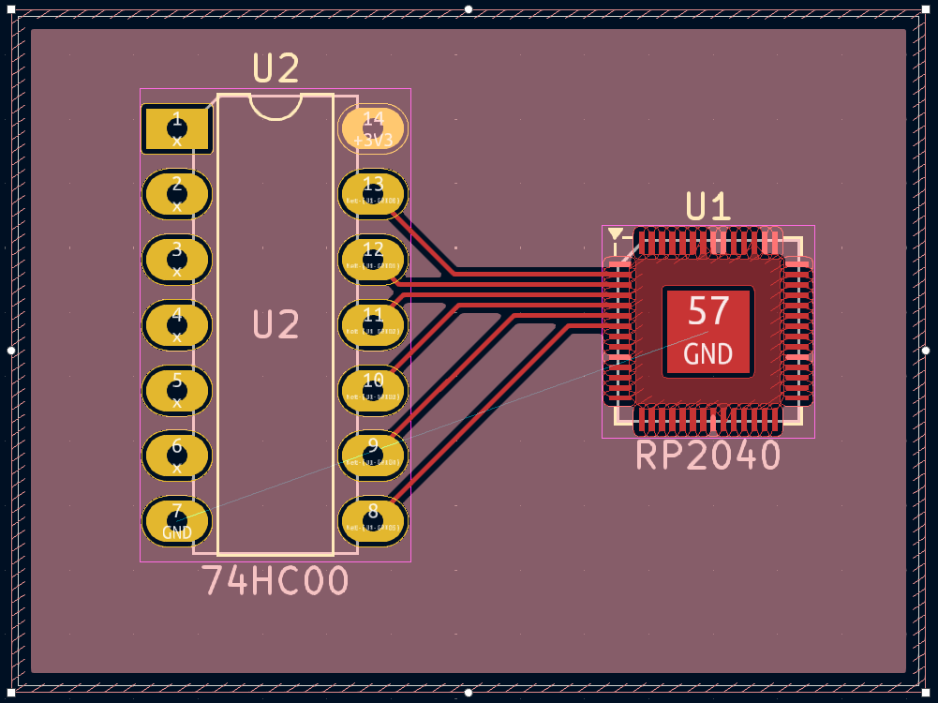
Design Process
… It’s good practice to use fill zones

Slide 16
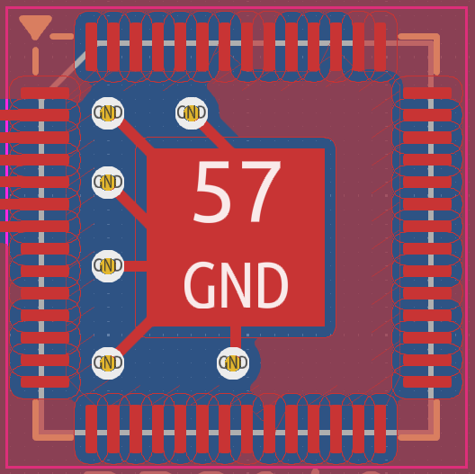
Design Process
Use vias to connect copper between layers.

Slide 17

Other considerations
Thermal spokes for easy soldering

Slide 18
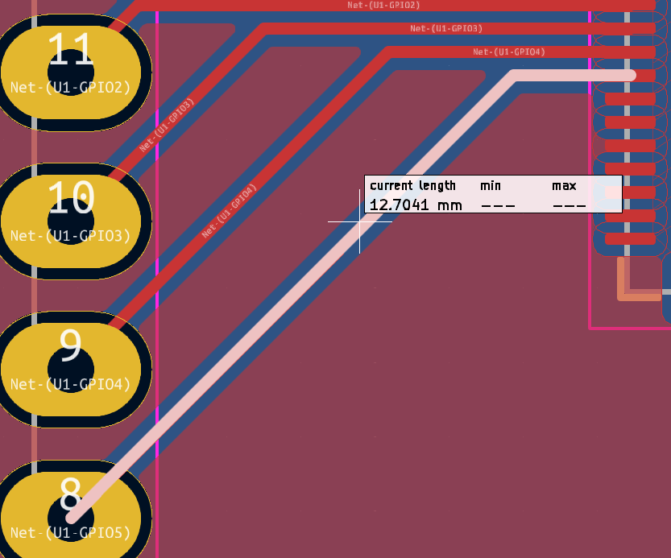
Other considerations
Length tuning
Minimize signal delay difference

Slide 19
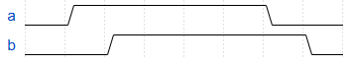
Other considerations
Signal delayed

Slide 20
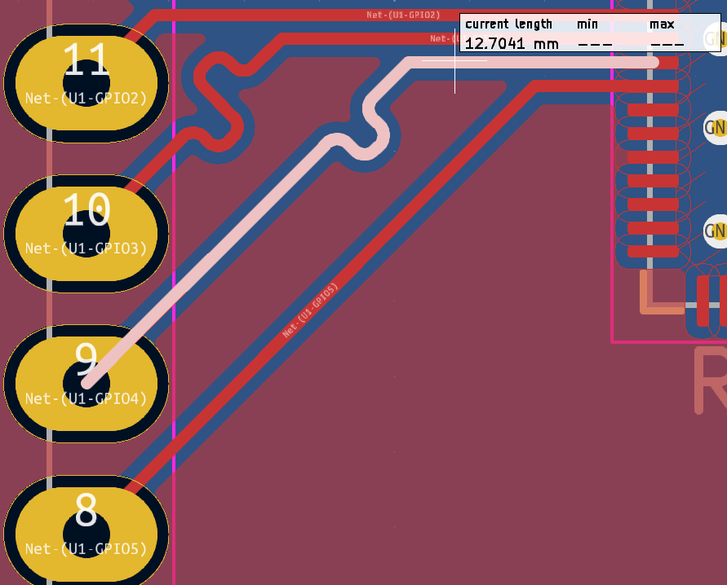
Other considerations
Bent track increases delay

Slide 21
Other Considerations
Pullup/down resistors
Decoupling capacitors

Slide 22

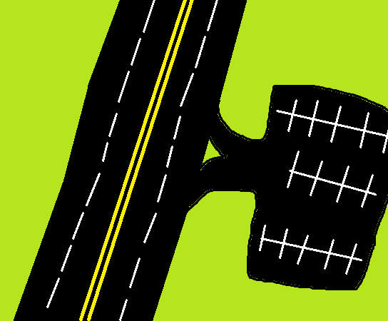
What are these?
Resistor
Capacitor
FREE
Cars!

Slide 23
Issues Encountered

Slide 24
EAR99
JLCPCB requires EAR99 if IC
EAR99 – US export regulation?
Repurchased some parts

Slide 25
LDC2114 Size
Kicad footprint - 0.5 mm pitch
Actual component - 0.4 mm pitch
Not manufacturable

Slide 26
Bad component choices
CAP1208? CAP1214?
esp32?
Discontinued stuff

Slide 27
RP2040 GPIO USAGE
RP2040 supports 2 active I2C channels.
Workaround.
I2C multiplexer?
27

Slide 28
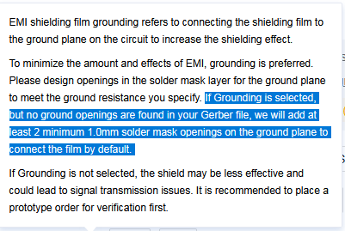
Manufacturer Confusion
Engineers thought Test Points Desired
Don’t expect English
Don’t assume contractors read

Slide 29
Component Delays

Slide 30
Component Delays

Slide 31
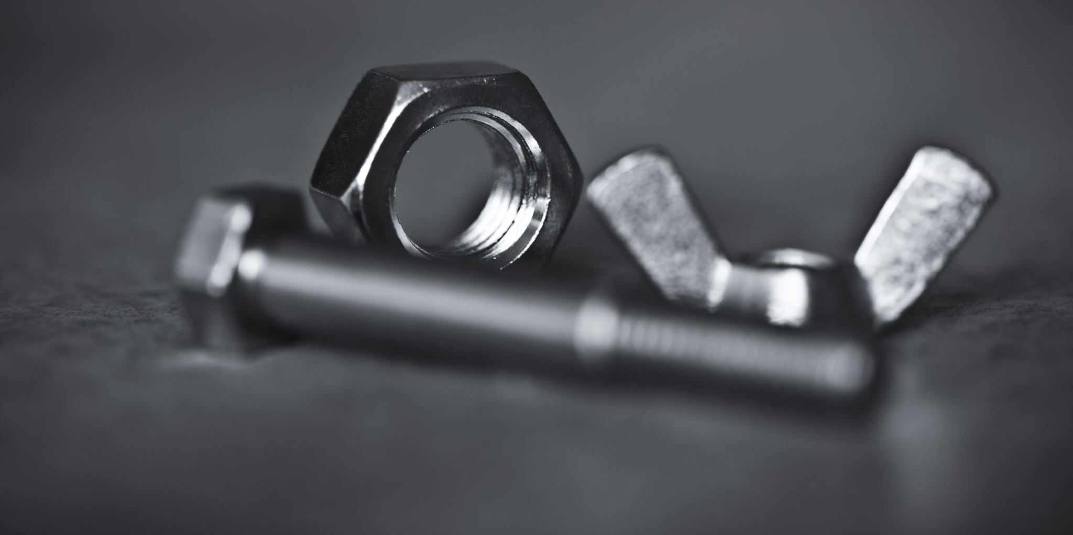

Assembly
Screws take up space
31

Slide 32
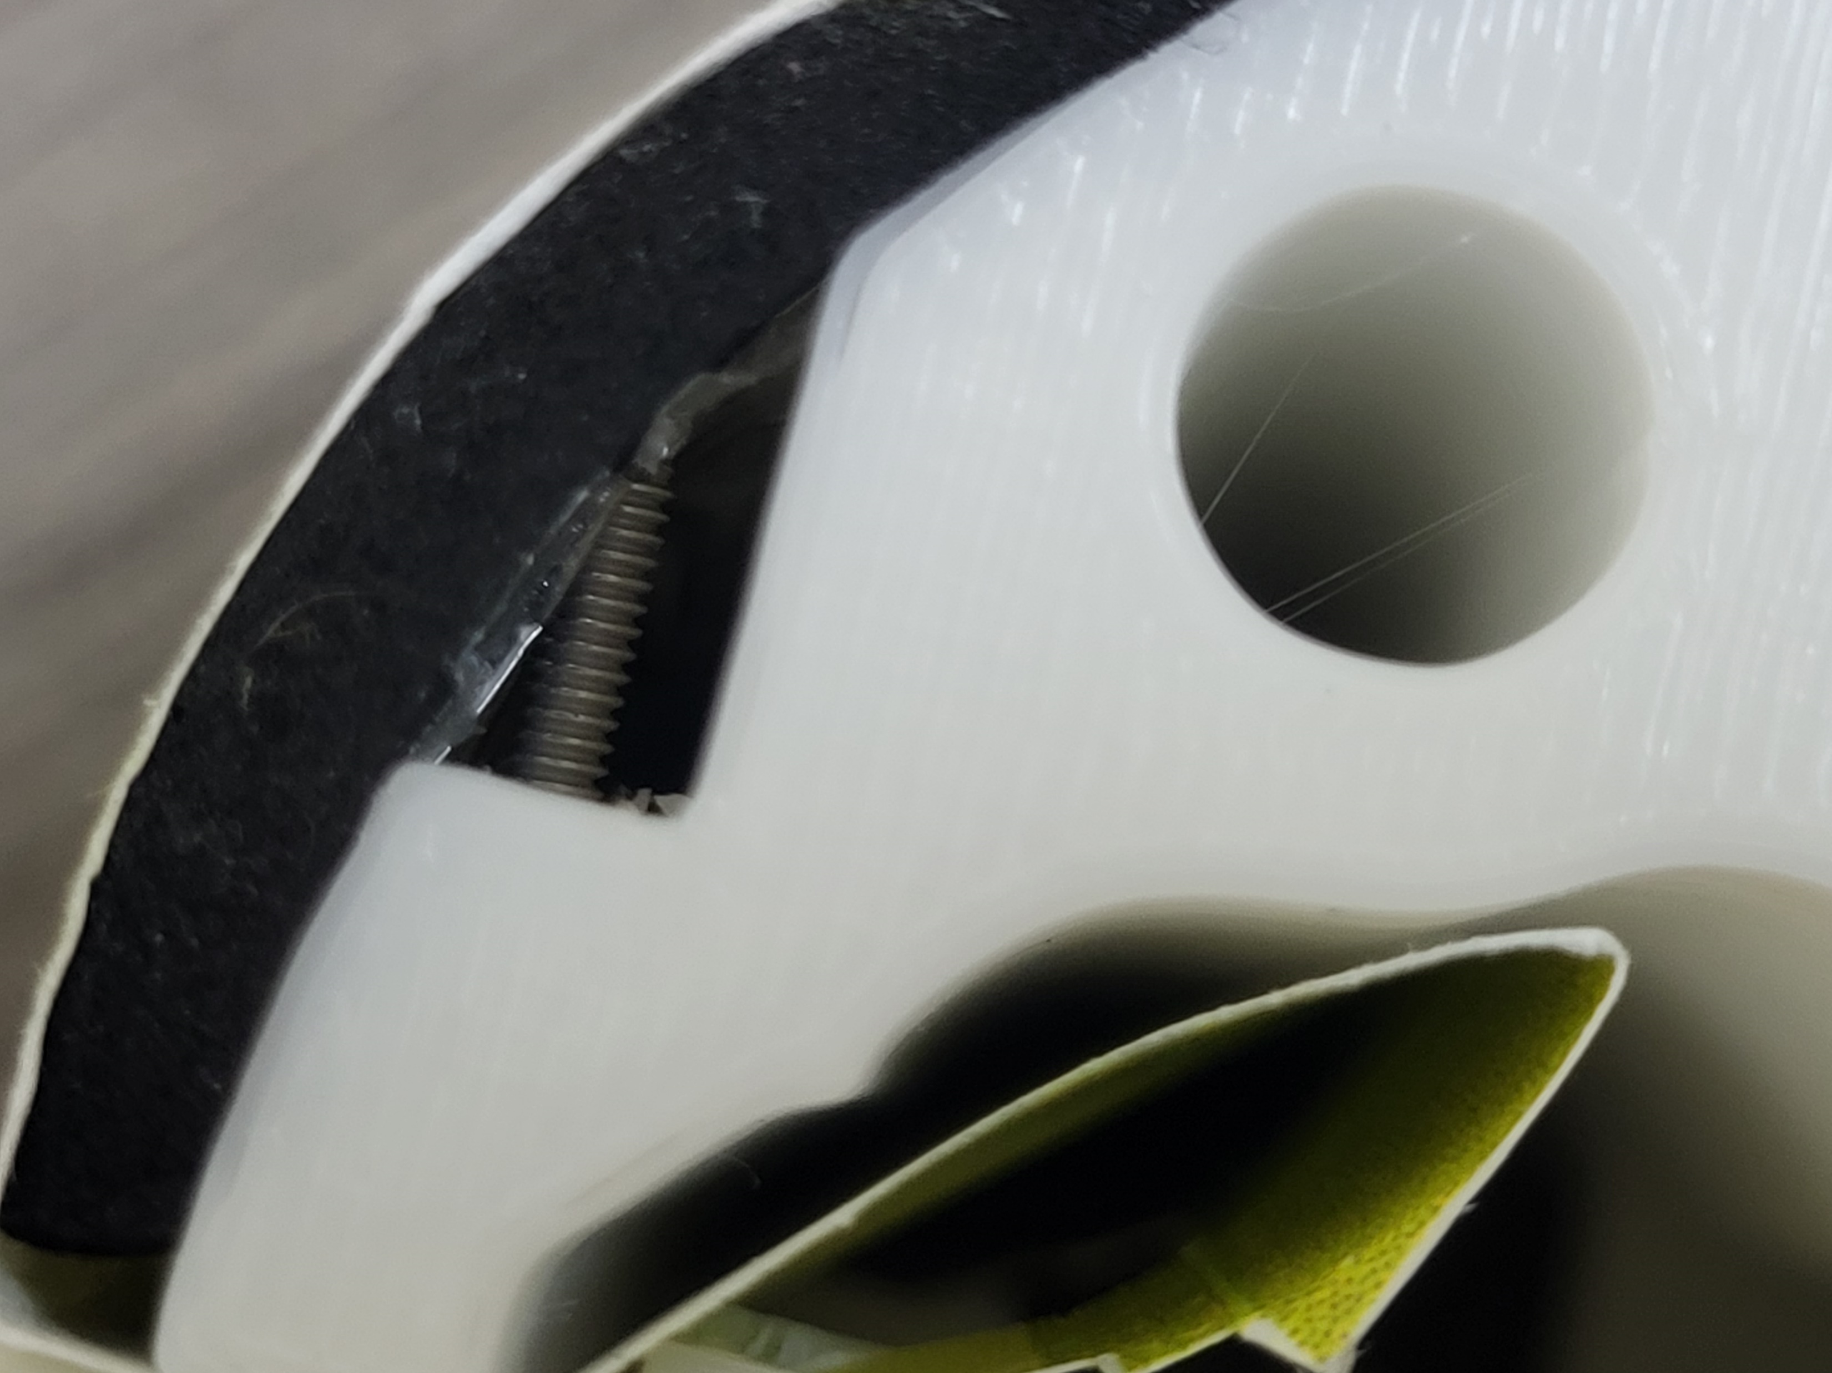

Slide 33
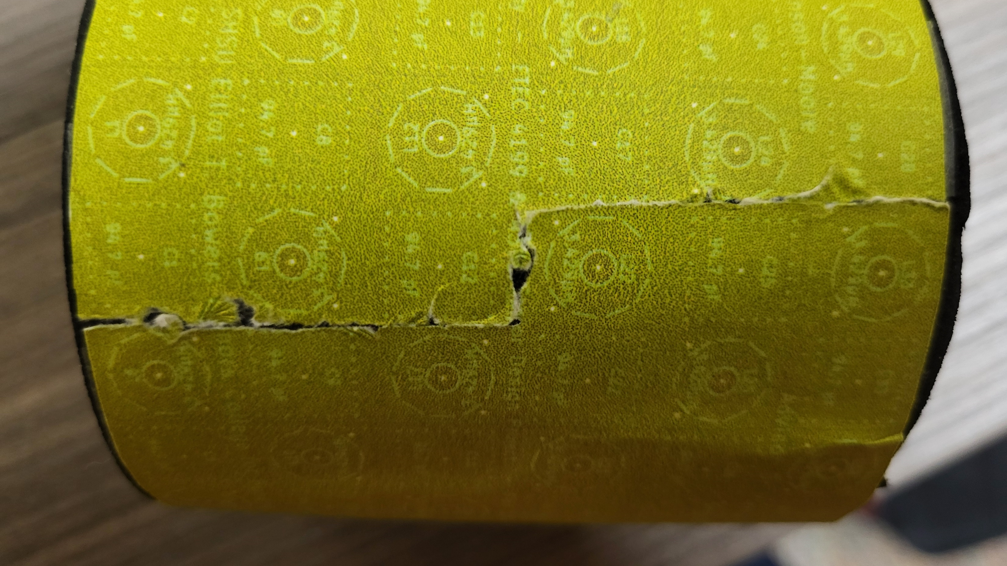

Slide 34
Raspberry Pi RP235xX
RP2040
RP235xX
133 MHz
264 kB RAM
External storage
150 MHz (++performance)
520 kB RAM
[Optional] internal storage

Slide 35
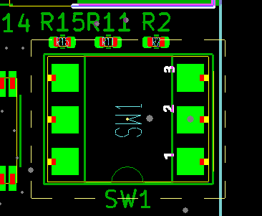
Switch incompatibility
KiCad default footprint
SMT switches not standardized
Few compatible switches
No stock
Image credit to JLCPCB engineer Mia Xi

Slide 36
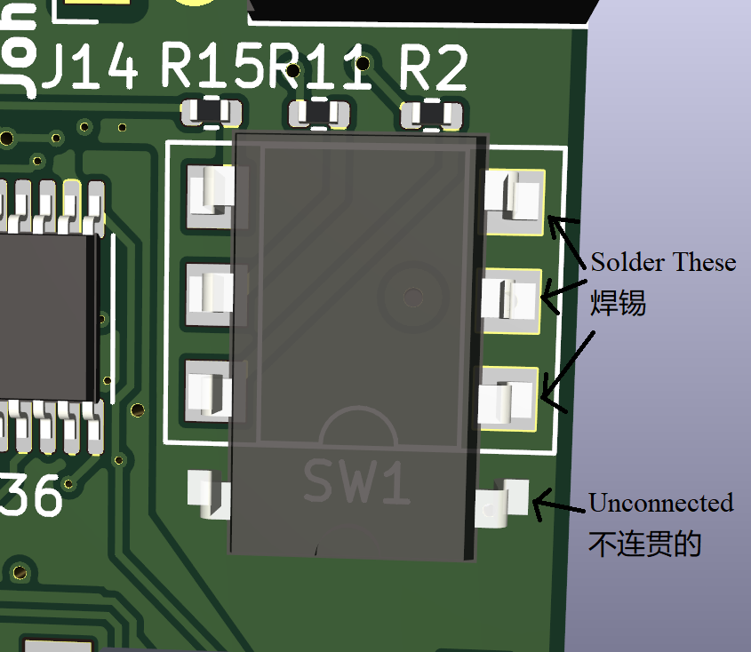
Switch incompatibility fix
Extra switch
Fits KiCad footprint
Enough unused space

Slide 37
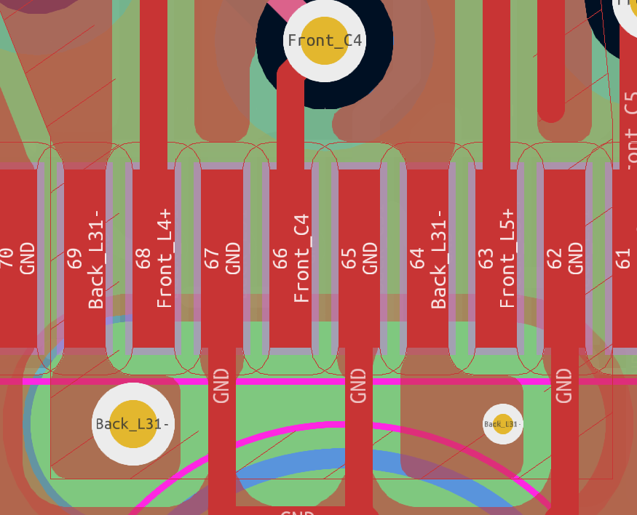
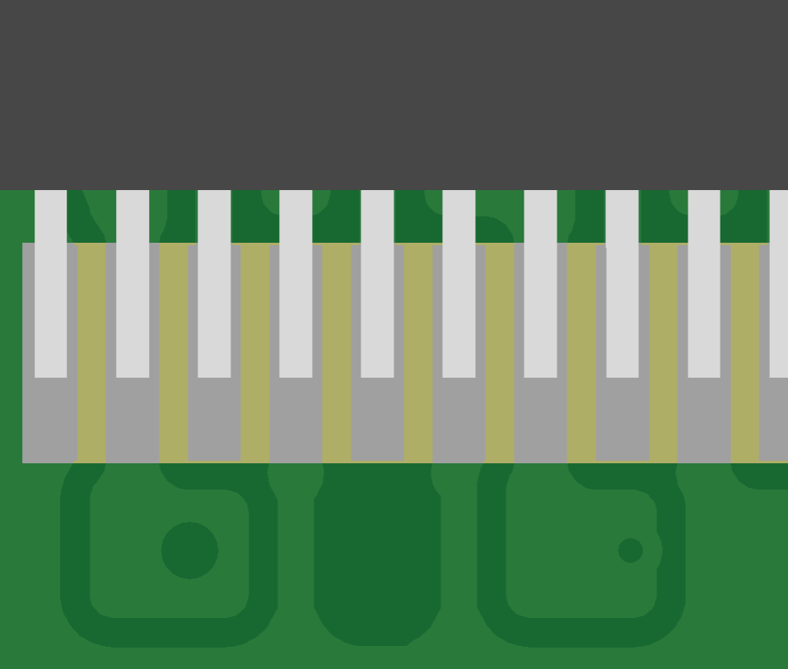
Possible Solder Shorting
Soldermask too small
CAD – 0.09 mm
Manufacturing tolerance – 0.2 mm
KiCAD deleted without warning
Image credit to JLCPCB (autogenerated)

Slide 38
Possible Solder Shorting
Went unnoticed until after manufacturing started
JLCPCB offered $38.46 / $301.13 refund
With $22 restocking fee
Worked out

Slide 39
References
D. Hou and D. Dolezilek, “IEC 61850 – what it can and cannot offer to traditional protection schemes,” SEL Journal of Reliable Power, vol. 1, no. 2, Oct. 2010. [Online]. Available: https://cdn.selinc.com/assets/Literature/Publications/Technical%20Papers/6335_IEC61850_DH-DD_20080912_Web.pdf
R. Lent, F. A. C. Azevedo, C. H. Andrade-Moraes, and A. V. O. Pinto, “How many neurons do you have? some dogmas of quantitative neuroscience under revision,” European Journal of Neuroscience, vol. 35, no. 1, pp. 1–9, 2012. [Online]. Available: https://onlinelibrary.wiley.com/doi/abs/10.1111/j.1460-9568.2011.07923.x
M. Islam, G. Chen, and S. Jin, “An overview of neural network,” American Journal of Neural Networks and Applications, vol. 5, no. 1, pp. 7–11, 2019. [Online]. Available: https://doi.org/10.11648/j.ajnna.20190501.12
(2021, Aug.) Inductive sensing design calculator tool. Texas Instruments. [Online]. Available: https://www.ti.com/tool/download/ LDC-CALCULATOR-TOOLS
RP2040 Datasheet: A microcontroller by Raspberry Pi, eec2b0cclean ed., Raspberry Pi, Oct. 2024. [Online]. Available: https://datasheets.raspberrypi.com/rp2040/rp2040-datasheet.pdf
Raspberry Pi Pico Pinout, Raspberry Pi. [Online]. Available: https://datasheets.raspberrypi.com/pico/Pico-R3-A4-Pinout.pdf
Hardware design with RP2040: Using RP2040 microcontrollers to build boards and products, 2nd ed., Raspberry Pi, Oct. 2024. [Online]. Available: https://datasheets.raspberrypi.com/rp2040/hardware-design-with-rp2040.pdf
spiflash® 3V 128M-BIT SERIAL FLASH MEMORY WITH DUAL/QUAD SPI & QPI & DTR, C ed., winbond, Mar.2018. [Online]. Available: https://www.winbond.com/resource-files/w25q128jv_dtr%20revc%2003272018%20plus.pdf
1.0 A Low-Dropout Positive Fixed and Adjustable Voltage Regulators NCP1117, NCP1117I, NCV1117, 31st ed., onsemi, Aug. 2021. [Online]. Available: http://www.onsemi.com/pub_link/Collateral/NCP1117-D.PDF
CAP1206: 6-Channel Capacitive Touch Sensor, DS00001567B ed., Microchip Technology, Nov. 2015. [Online]. Available: https://www.microchip.com/en-us/product/cap1206
LDC3114 4-Channel Hybrid Inductive Touch and Inductance to Digital Converter, 1st ed., Texas Instruments, Dec. 2021. [Online]. Available: https://www.ti.com/lit/ds/symlink/ldc3114.pdf
LDC2112, LDC2114 Inductive Touch Solution for Low-Power HMI Button Applications, B ed., Texas Instruments, Jan. 2017. [Online]. Available: https://www.ti.com/lit/ds/symlink/ldc2114.pdf
SN5430, SN54LS30, SN54S30, SN7430, SN74LS30, SN74S30, 8-Input Positive-NAND Gates, Texas Instruments, Mar. 1988. [Online]. Available: https://www.ti.com/lit/ds/symlink/sn74ls30.pdf
SN5432, SN54LS32, SN54S32, SN7432, SN74LS32, SN74S32, Quadruple 2-Input Positive-OR Gates, Texas Instruments, Mar. 1988. [Online]. Available: https://www.ti.com/lit/ds/symlink/sn74ls32.pdf
CY7C65632, CY7C65634: HX2VL - Very Low-Power USB 2.0 Hub Controller, O ed., infineon, Oct. 2024. [Online]. Available: https://www.infineon.com/dgdl/Infineon-CY7C65632_CY7C65634_HX2VL_VERY_LOW-POWER_USB_2.0_HUB_CONTROLLER-DataSheet-v14_00-EN.pdf?fileId=8ac78c8c7d0d8da4017d0ecd35994769&utm_source=cypress&utm_medium=referral&utm_campaign=202110_globe_en_all_integration-files&redirId=File_1_1_521
Data sheet: FR202xxHBDN, W ed., Metz Connect, Dec. 2024. [Online]. Available: https://media.metz-connect.com/files/171/Data_sheet_FR202XXHBDN.PDF
Data sheet: PR202xxHBDN, W ed., Metz Connect, Dec. 2024. [Online]. Available: https://media.metz-connect.com/files/171/Data_sheet_PR202XXHBDN.PDF

Slide 40

Questions?

